Slide 1
Version Control
CS 441, Spring 2020, Yongjie Zheng

Slide 2
Fundamental Concepts
Version Control
  The management of evolution of software systems.
Repository (Depot)
  The place where all completed work is stored, including
    The current state of the project;
    The entire history (i.e. changes) of the project: when each change was made, who made it, and a text log message.
Working copy
  The local reflection of the repository's files and directories.
Baseline / Trunk
  The “primary” location for code in the repository. Think of code as a family tree — the “trunk” is the main line.
CS 441 Software Engineering

Slide 3
Version Control
Mission
  Keep track of all old versions of files
    Every file in the system has a full history of changes and can easily be restored to any version in its history. Each version has a unique identifier that looks like a string of letters and numbers.
  Enable collaborative editing and sharing of data
    How to prevent users from accidentally overwriting each other's changes?
    Help developers communicate their changes to each other.
CS 441 Software Engineering

Slide 4
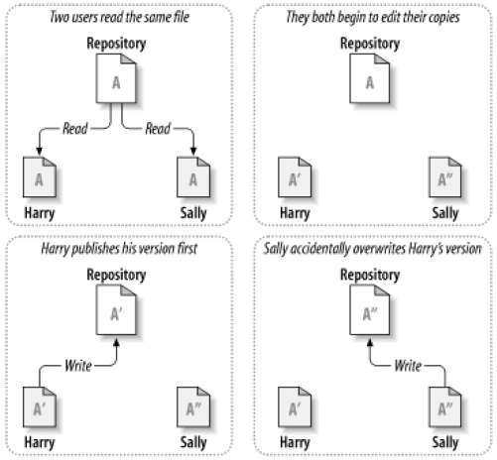
The problem of sharing
As a result, Harry’s work is lost in the latest version of the file!
CS 441 Software Engineering

Slide 5
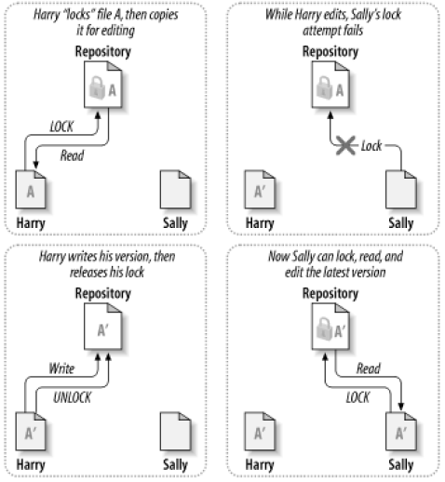
The lock-modify-unlock solution
The repository allows only one person to change a file at a time.
One must “lock” a file before making changes to it.
The user can only read the file that is locked by others.
CS 441 Software Engineering

Slide 6
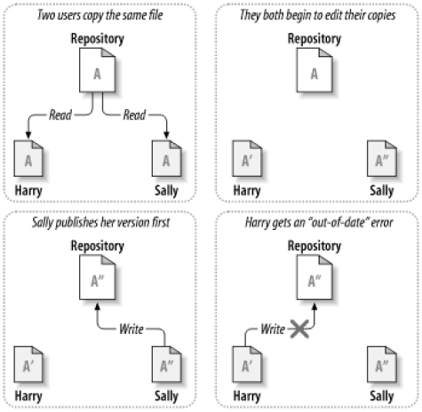
The copy-modify-merge solution
Users can work simultaneously and independently on their private copies of the same file.
The repository will inform the user that their file is out of date when the user is trying to upload their changes.
CS 441 Software Engineering

Slide 7
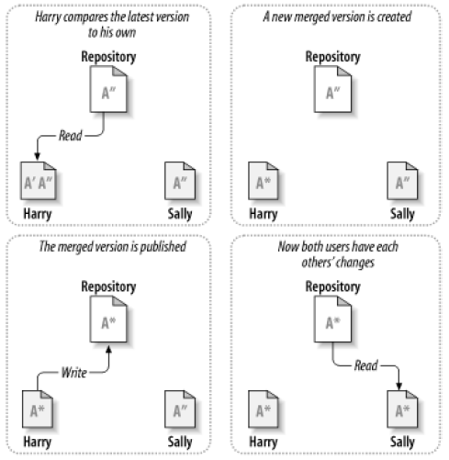
The copy-modify-merge solution, cont.
In response, the user needs to merge any new changes from the repository into their own working copy before they can commit.
The user may need to resolve conflicts in the process of merging.
CS 441 Software Engineering

Slide 8
Strategies (Versioning Models)
Lock-Modify-Unlock (Pessimistic Model)
  Only one person is allowed to change a file at a time.
  Problem: over restrictive, inhibit productivity.
Copy-Modify-Merge (Optimistic Model)
  Each user creates and edits a personal working copy, and finally copies are merged into a new version.
  Most current version control systems use this mechanism.
  Problem: some files are hard to merge, such as files of binary formats.
CS 441 Software Engineering

Slide 9
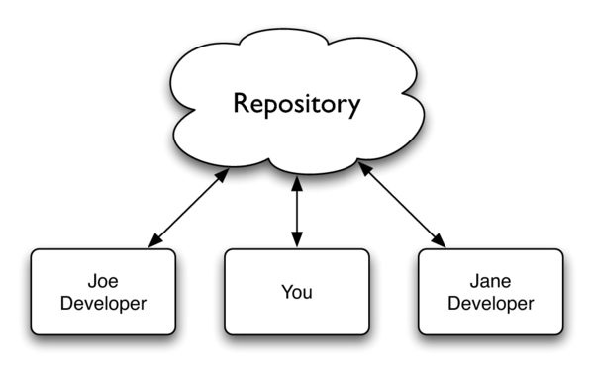
Repository Model
Centralized (Client-Server) Repository Model
CS 441 Software Engineering

Slide 10
Repository Model
Centralized (Client-Server) Repository Model
  There is a central repository (server) that holds all of the versioned data.
  Users (clients) change their working copies, and update the repository to incorporate those changes.
  Users have to maintain a network connection to the central repository in order to track the changes that they make.
CS 441 Software Engineering

Slide 11
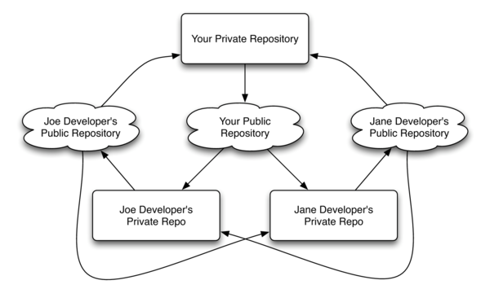
Repository Model
Decentralized Repository Model
CS 441 Software Engineering

Slide 12
Repository Model
Decentralized Repository Model
  Each developer has their own copy of the repository that includes complete history.
  Anyone can be a server.
  Each developer has a public repository and a private repository
    Public repository is to share changes with other developers
    Private repository is to manage drafts that they don’t want to publish
  Network is not involved in most operations.
  Allows users to work productively even when not connected to a network.
CS 441 Software Engineering

Slide 13
Version Control Systems
Centralized
  Open-source
    CVS, Subversion
  Commercial
    Visual SourceSafe, Perforce
Decentralized
  Open-source
    Monotone, Git
  Commercial
    TeamWare, BitKeeper
CS 441 Software Engineering

Slide 14
Important Operations of Version Control
Basic Operations
  Add
  Check in
  Check out
  Update
  Head
  Revert
Advanced Operations
  Branch
  Merge
  Tag
  Diff / Delta
CS 441 Software Engineering

Slide 15
Basic Operations
Add
  Put a file into the repository for the first time, i.e. begin tracking it with Version Control.
Check out
  Download a file from the repository. Checking out a repository creates a “working copy” of it on your local machine.
  The working copy becomes editable (Pessimistic Model only).
Check in (Commit)
  Upload a file to the repository (if it has changed). The file gets a new revision number (per file v.s. per repository).
  The working copy becomes read only (Pessimistic Model only).
CS 441 Software Engineering

Slide 16
Basic Operations
Update
  Refresh the local or working copy with any changes since checkout.
Head
  The latest revision in the repository (the most recent commit).
Revert
  Throw away your local changes and reload the latest version from the repository.
CS 441 Software Engineering

Slide 17
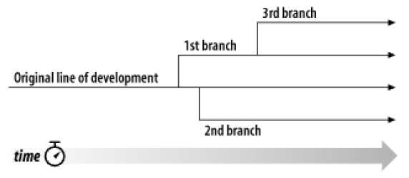
Branch
Lines of development that exist independently and share a common history.
Each branch generates its own history.
CS 441 Software Engineering

Slide 18
Merge
To take some changes which were done to one branch and apply them to another branch.
Can cause conflicts
  Require user intervention
Other issues
  Merging histories
  Repeated merge
CS 441 Software Engineering

Slide 19
Tag
A “snapshot” of a project in time.
A name that is given to a particular commit; the name that you want that particular commit to be represented by.
Makes it easy to check out a release or configuration.
CS 441 Software Engineering

Slide 20
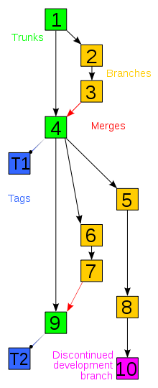
Branch, Merge, and Tag
CS 441 Software Engineering

Slide 21
Diff/Delta
Diff/Delta: a specific modification to a document under version control.
Most version control systems store diffs rather than full copies of the file to save disk space (Delta Compression).
CS 441 Software Engineering

Slide 22
Best Practices
Explain your checkins completely.
Keep in touch with the repository (update often).
Checkin your work to the repository as often as you can without breaking the build (commit often).
Review the merge before you commit.
Use checkout and revert with caution.
CS 441 Software Engineering

Slide 23
Reference
Pragmatic Version Control Using Git by Travis Swicegood
Wikipedia:Revision control.
Version Control with Subversion by Ben Collins-Sussman, Brian W. Fitzpatrick, and C. Michael Pilato.
  Many diagrams of this lecture are from this book.
  The book is free online: http://subversion.apache.org
CS 441 Software Engineering

